Slide 1

Face recognition
Learning Objectives:
Differentiate between face recognition and face verification
Implement one-shot learning to solve a face recognition problem
Apply the triplet loss function to learn a network's parameters in the context of face recognition
Explain how to pose face recognition as a binary classification problem
Map face images into 128-dimensional encodings using a pretrained model

Slide 2
Face recognition
Learning Objectives:
Perform face verification and face recognition with these encodings
Implement the Neural Style Transfer algorithm
Generate novel artistic images using Neural Style Transfer
Define the style cost function for Neural Style Transfer
Define the content cost function for Neural Style Transfer

Slide 3
Face recognition
1 What is face recognition?
2 One-shot learning
3 Siamese network
4 Triplet loss
5 Face verification and binary classification
6 What is neural style transfer?
7 What are deep ConvNets learning?
8 Cost function
9 Content cost function
10 Style cost function
11 1D and 3D generalizations of models

Slide 4
Face recognition
What is face recognition?

Slide 5
Face recognition
Face recognition is a special application of convolutional neural networks.
Face verification is a one-to-one problem where the system verifies whether an input image matches the claimed identity of a person.
Face recognition is a much harder problem that involves identifying a person from a database of many people.
Face recognition requires high accuracy, which is difficult to achieve due to the one-shot learning problem.
The next section will discuss how to build a face verification system, which can be used as a building block for a face recognition system.

Slide 6
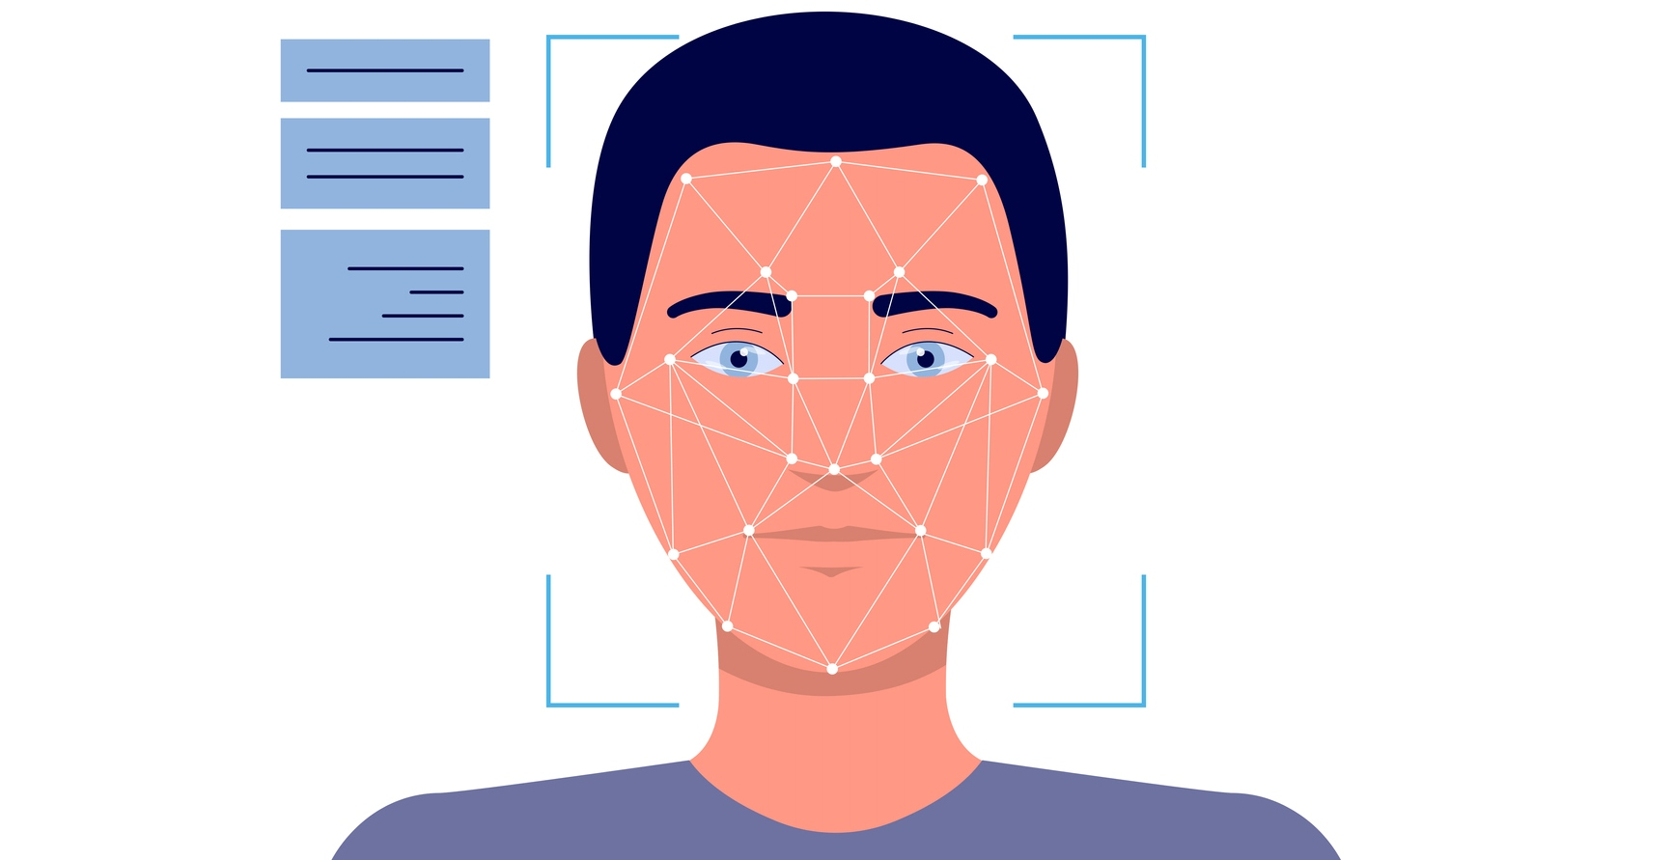
Face recognition

Slide 7
Face verification vs. face recognition
Verification
Input image, name/ID
Output whether the input image is that of the claimed person
Recognition
Has a database of K persons
Get an input image
Output ID if the image is any of the K persons (or “not recognized”)

Slide 8
Face recognition
One-shot learning

Slide 9
One-shot learning
The one-shot learning problem with face recognition is recognizing a person with just one image. A ConvNet with a softmax unit can output a label, but it doesn't work well for a small training set and requires retraining for each new person.
A similarity function, denoted as d, is learned using a neural network that inputs two images and outputs the degree of difference between them. If the difference is less than a threshold, the two images are predicted to be of the same person. This function d solves the one-shot learning problem and allows adding new people to the database without retraining the network.
Notes:
The challenge with face recognition is that you often need to recognize a person with just one single image or example of their face. This is known as the one-shot learning problem.
Historically, deep learning algorithms have not worked well with just one training example. For example, if you have a database of four pictures of employees, the system must recognize someone who has only one image in the database. One approach is to input the image of the person and feed it to a ConvNet to output a label using a softmax unit with four or five outputs corresponding to each person or none of the above.
However, this approach does not work well for a small training set and requires retraining every time a new person is added. Instead, a similarity function is learned using a neural network, denoted as d, which inputs two images and outputs the degree of difference between them. If the two images are of the same person, d outputs a small number, and if the two images are of different people, d outputs a large number. During recognition time, if the degree of difference is less than a threshold, tau, then the two pictures are predicted to be of the same person. This function d allows you to address the one-shot learning problem, and you can add a new person to the database without retraining the network. In the next video, you will learn how to train a neural network to learn the similarity function d.

Slide 10




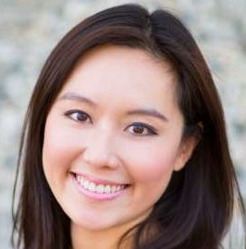

One-shot learning
Learning from one example to recognize the person again

Slide 11


Learning a “similarity” function
d(img1,img2) = degree of difference between images If d(img1,img2) ≤ -
> -

Slide 12
Face recognition
Siamese network

Slide 13
Siamese network
A face recognition system needs to be able to recognize a person based on just one single image or example of that person's face. This is known as the one-shot learning problem, and it is challenging because deep learning algorithms historically do not work well with only one training example.
One approach to solving this problem is to learn a similarity function, denoted as d, that inputs two images and outputs the degree of difference between them.

Slide 14
Siamese network
During recognition, if two images have a degree of difference below a certain threshold called tau, they are considered to be of the same person.
The Siamese network architecture is used to train a neural network to learn the similarity function. This involves running two identical convolutional neural networks on two different inputs and comparing them. The objective function is to learn parameters that make the distance between the encodings of images of the same person small and that of images of different persons large. The triplet loss function is used to define this objective function.
Notes:
During recognition time, if the degree of difference between two images is less than some threshold called tau, then the two images are predicted to be of the same person.
To train the neural network to learn the similarity function, a Siamese network architecture is used. This architecture involves running two identical convolutional neural networks on two different inputs and then comparing them. The parameters of the neural network define an encoding f of xi, and the objective function is to learn parameters so that if two pictures xi and xj are of the same person, then the distance between their encodings should be small, and if they are of different persons, then the distance between their encodings should be large. The triplet loss function is used to define this objective function.

Slide 15
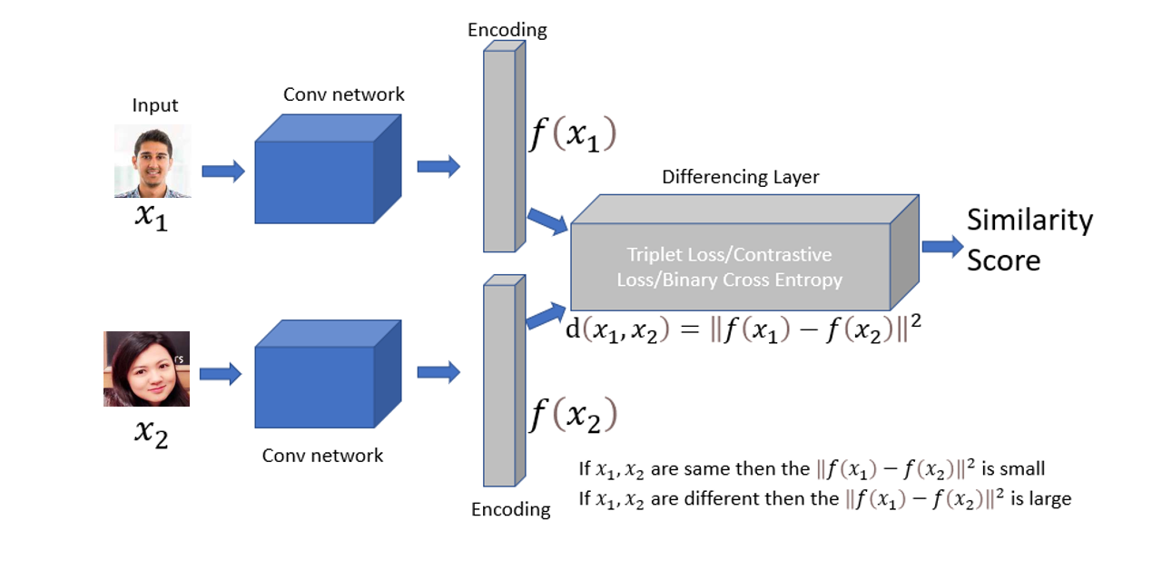
Siamese network
d(x⁽¹⁾ ,x⁽²⁾) = || f(x⁽¹⁾ - f(x⁽²⁾) ||²₂

Slide 16
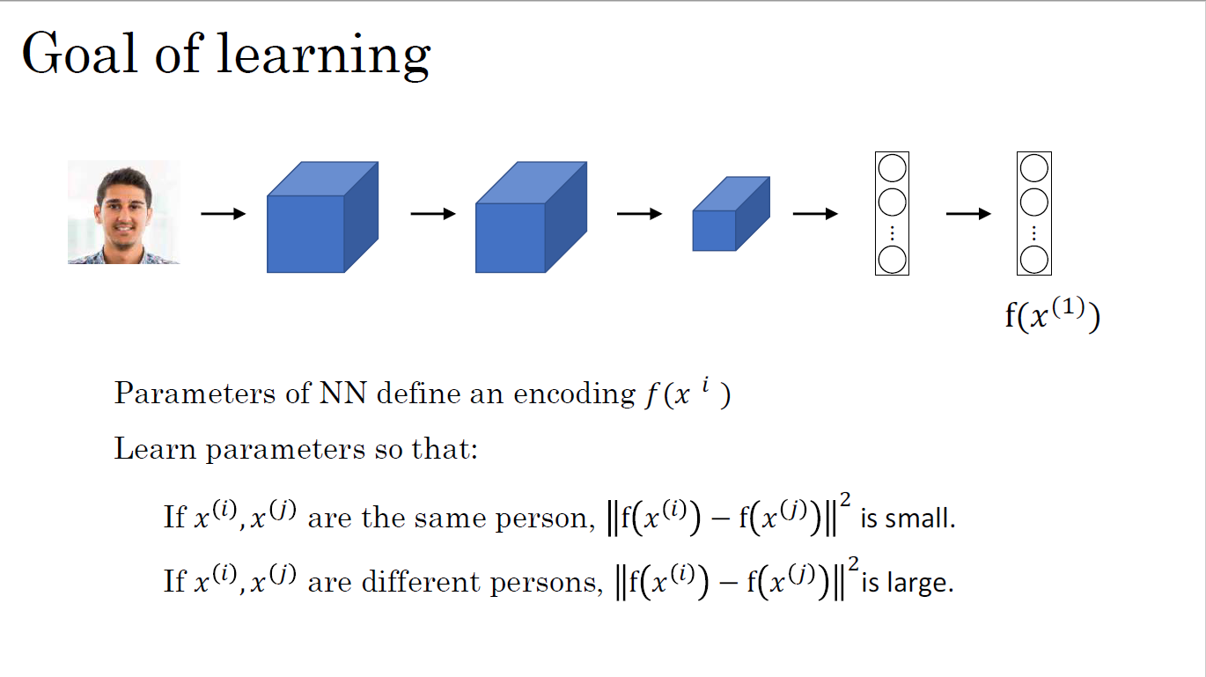

Slide 17
Face recognition
Triplet loss

Slide 18
Triplet loss
The triplet loss is a loss function used to train a neural network to encode images such that the encoding of images of the same person is closer together in some sense than the encoding of images of different people.
The triplet loss is defined by looking at triplets of images: an anchor image (A), a positive image (P), and a negative image (N).
The positive image is an image of the same person as the anchor, while the negative image is an image of a different person than the anchor.
The goal of the triplet loss is to minimize the distance between the anchor and positive images while maximizing the distance between the anchor and negative images.

Slide 19
Learning Objective
Formally, the triplet loss is defined as L=max(||f(A)-f(P)||^2-||f(A)-f(N)||^2+α,0), where f(.) is the encoding function, ||.|| is the L2-norm, and α is a margin parameter that is used to make sure the neural network does not output trivial solutions

Slide 20
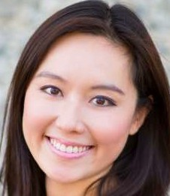





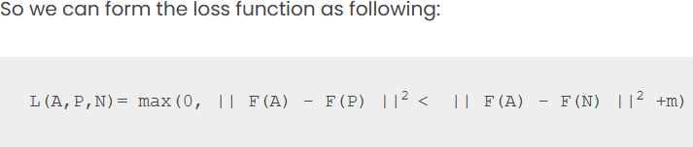
Learning Objective
Anchor
A
Positive
P
Anchor
A
Negative
N

Slide 21
Loss function
To train the neural network using the triplet loss, a dataset of triplets must be constructed.
However, choosing triplets randomly can be computationally inefficient, as too many triplets may be too easy for the neural network to learn. Instead, it is recommended to choose "hard" triplets, where the distance between the anchor and positive images is close to the distance between the anchor and negative images.

Slide 22

Loss function
J = ∑^{m}_{i=1}L(A^{(i)},P^{(i)},N^{(i)})
Training set: 10k pictures of 1k persons

Slide 23
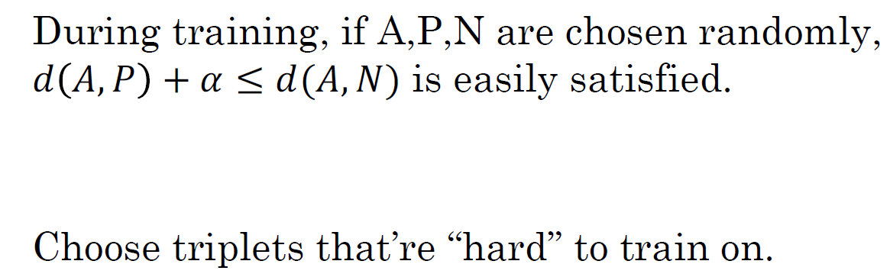
Choosing the triplets A,P,N
||f(A) - f(P)||² + 𝝰 ⩽ ||f(A) - f(N)||²
d(A,P) + 𝝰 ⩽ d(A,N)
d(A,P) ≅ d(A,N)

Slide 24
Training set using triplet loss
Large-scale face recognition systems are often trained on datasets with millions or even tens of millions of images, making it difficult to train a model from scratch. Therefore, it may be useful to download pre-trained models from companies that have posted their parameters online. However, it is still important to understand how these algorithms were trained in case modifications or new applications are needed.

Slide 25






Training set using triplet loss
Anchor Positive Negative
J
d(x^{(i)} ,x^{(j)})
⋮
⋮
⋮

Slide 26
Face recognition
Face verification and binary classification

Slide 27
Face verification and binary classification
The Triplet Loss and the Siamese Network are two methods for training a neural network to perform face recognition.
The Triplet Loss involves training a neural network to learn a 128-dimensional encoding of a face image that is unique to each individual.
The Siamese Network, on the other hand, treats face recognition as a binary classification problem, where the network takes in a pair of images and outputs a prediction of whether they depict the same person or not.

Slide 28
Learning the similarity function
The Siamese Network uses two neural networks to compute the embeddings for each image in a pair, and a logistic regression unit to predict whether the images depict the same person or not based on the absolute value of the differences between the embeddings. The network is trained on pairs of images using backpropagation to adjust the weights and improve the accuracy of the predictions.
Notes:
In the Siamese Network approach, two neural networks are used to compute the embeddings for each image in the pair. These embeddings are then fed into a logistic regression unit, which predicts whether the two images depict the same person or not. The logistic regression unit uses a formula that takes the absolute value of the differences between the embeddings as features, which are then weighted and combined to make the prediction.
During training, the Siamese Network is trained on pairs of images, where the target label is 1 if the images depict the same person and 0 if they depict different people. The network is trained using backpropagation to adjust the weights of the network to improve the accuracy of the predictions.

Slide 29
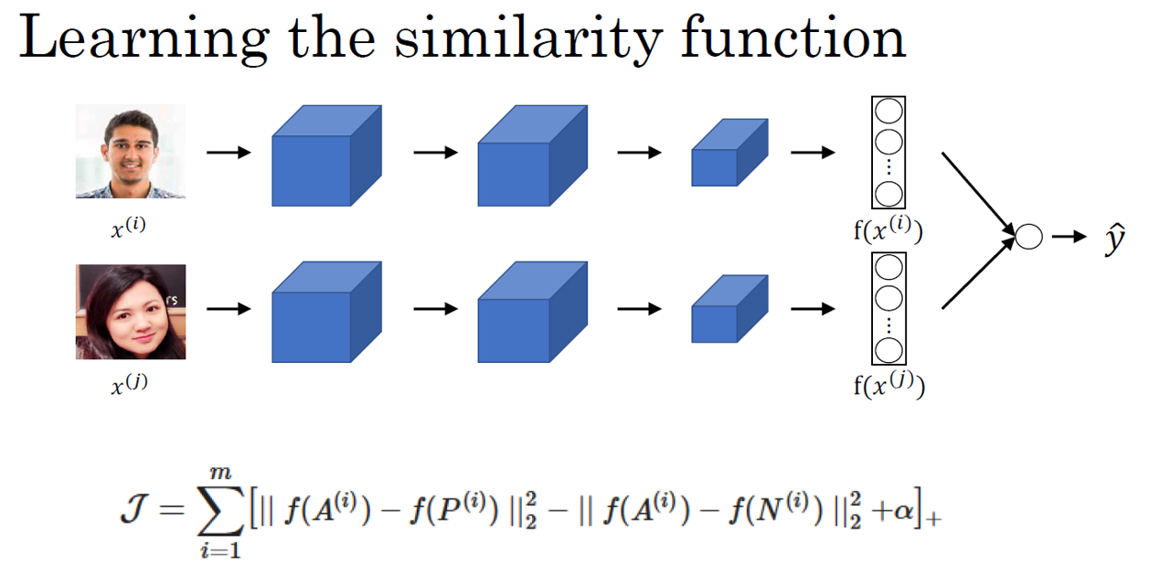
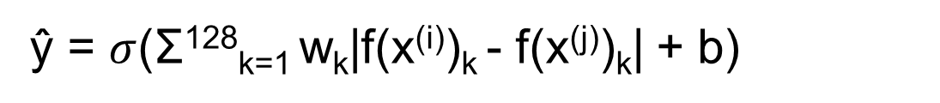
ŷ = $σ$(Σ¹²⁸_{k=1} w_{k}|f(x^{(i)})_{k} - f(x^{(j)})_{k}| + b)

Slide 30
Face verification supervised learning
To improve the efficiency of the face recognition system, pre-computed encodings can be used instead of computing the embeddings for each image in real-time. This can save significant computation time, especially for large databases of images.
Overall, both the Triplet Loss and Siamese Network approaches are effective ways to train a neural network for face recognition, and the choice between the two depends on the specific needs and constraints of the application.

Slide 31
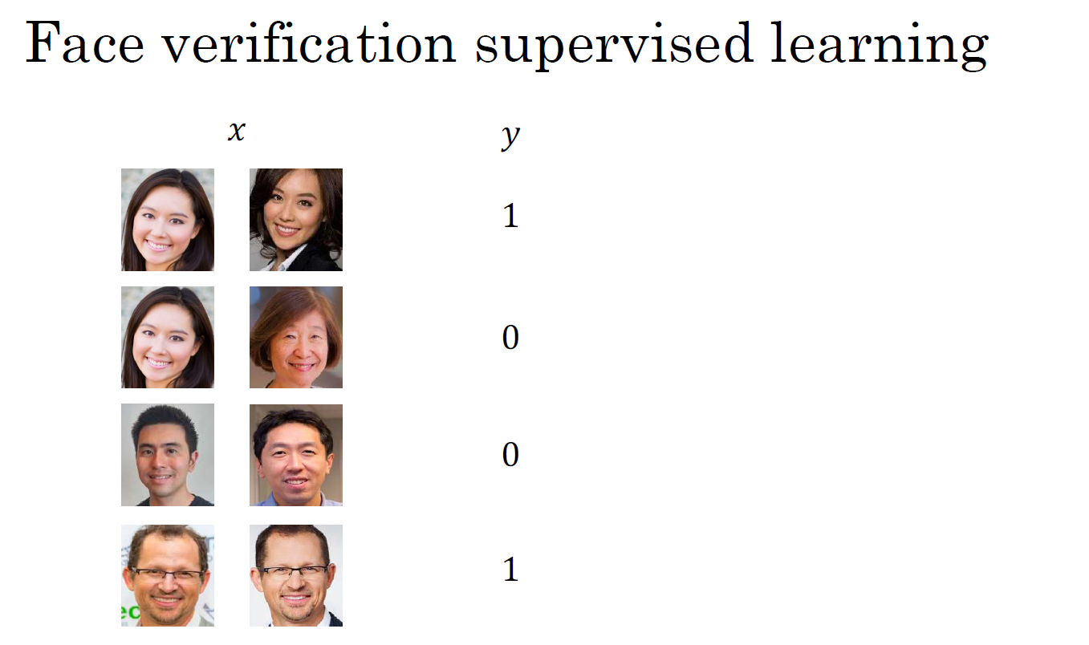

Slide 32
Neural Style Transfer
What is neural style
transfer?

Slide 33
What is neural style transfer?
Neural Style Transfer is a technique that allows you to generate new images by combining the content of one image with the style of another.
It works by using a pre-trained Convolutional Neural Network (ConvNet) to extract features from the content and style images.
The content image represents the subject matter of the new image, while the style image represents the desired style.
The output image is then generated by iteratively adjusting the pixel values of a random noise image until it matches the content and style representations.

Slide 34
Neural style transfer
To implement Neural Style Transfer, you need to first select a pre-trained ConvNet and extract features from the content and style images at various layers of the network.
The content representation is typically extracted from a deeper layer of the ConvNet, while the style representation is extracted from a shallow layer. The content representation is then used to guide the overall structure and subject matter of the generated image, while the style representation is used to determine the texture and color of the image.

Slide 35
Neural style transfer
Neural Style Transfer is a technique that involves adjusting the pixel values of a random noise image using an optimization algorithm to create an output image that combines the content of one image with the style of another.
This process minimizes a loss function that measures the difference between the features extracted from the content and style images and those extracted from the generated image.
The technique has become popular in recent years due to its ability to create visually appealing images, and it has been used in various fields like art, design, and advertising.
Notes:
The actual process of generating the output image involves iteratively adjusting the pixel values of a random noise image to minimize a loss function that measures the difference between the features extracted from the content and style images and those extracted from the generated image. This process is typically done using an optimization algorithm such as gradient descent.
Neural Style Transfer has become a popular application of ConvNet in recent years due to its ability to create unique and visually appealing images. It has been used in a variety of fields, including art, design, and advertising.

Slide 36
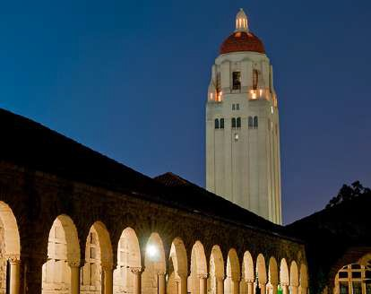
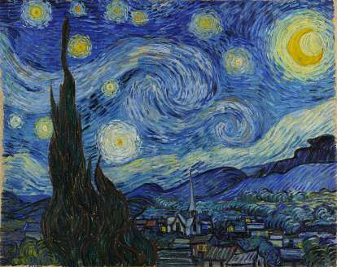
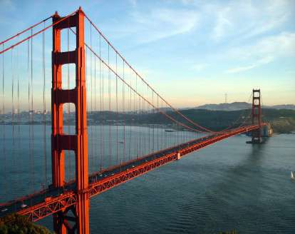
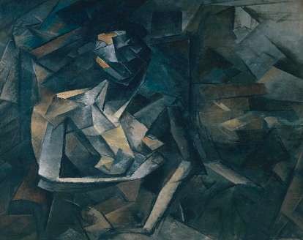
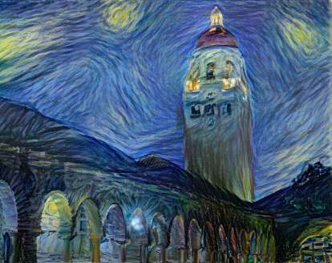
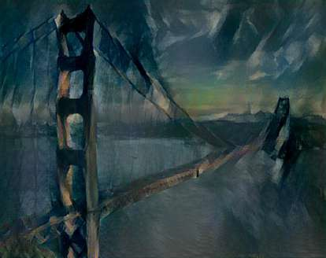
Neural style transfer
Content
Style
Content
Style
Generated image
Generated image

Slide 37
Neural Style
Transfer
What are deep ConvNets learning?

Slide 38
What are deep ConvNets learning?
Visualizations can help understand what deeper layers of ConvNets are computing.
The visualization technique involves finding the images or patches in the training set that maximize a particular hidden unit's activation.
Consider examples of visualizations of what different hidden units in various layers of a ConvNet are detecting, starting with layer 1 and moving to deeper layers.

Slide 39
Visualizing what a deep network is learning
In layer 1, the units are detecting relatively simple features such as edges or a particular shade of color.
In layer 2, the features detected are more complex shapes and patterns, such as vertical textures with lots of vertical lines or rounder shapes to the left part of the image.
In layer 3, the features detected are even more complex, such as detecting certain textures like honeycomb or square shapes.
In layer 4, the features detected become even more sophisticated, such as detecting dogs, water, or bird legs.
In layer 5, the features detected become even more varied, such as keyboards, text, or flowers.
This intuition is used to build a neural-style transfer algorithm.

Slide 40
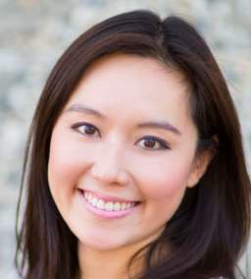

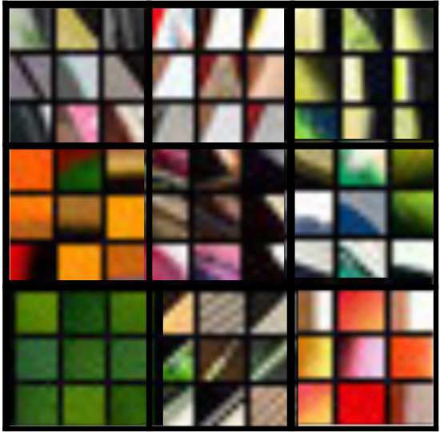
Visualizing what a deep network is learning
⋮
⋮
&'
26×26×256 13×13×256
13×13×384 13×13×384 6×6×256
55×55×96
FC FC 4096 4096
224×224×3
110×110×96
Pick a unit in layer 1. Find the nine image patches that maximize the unit’s activation.
Repeat for other units.

Slide 41
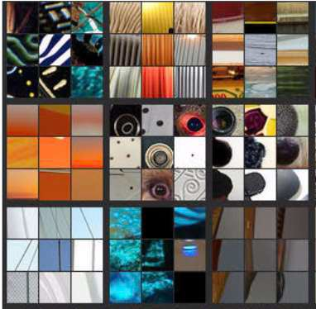
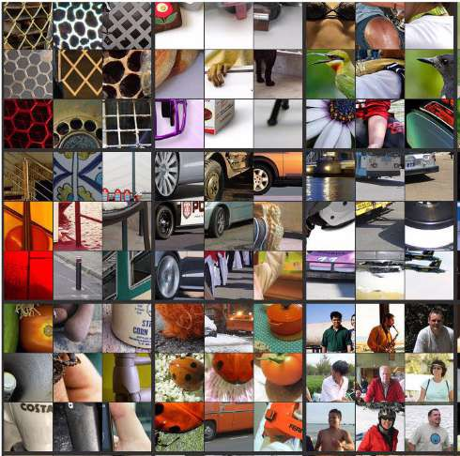
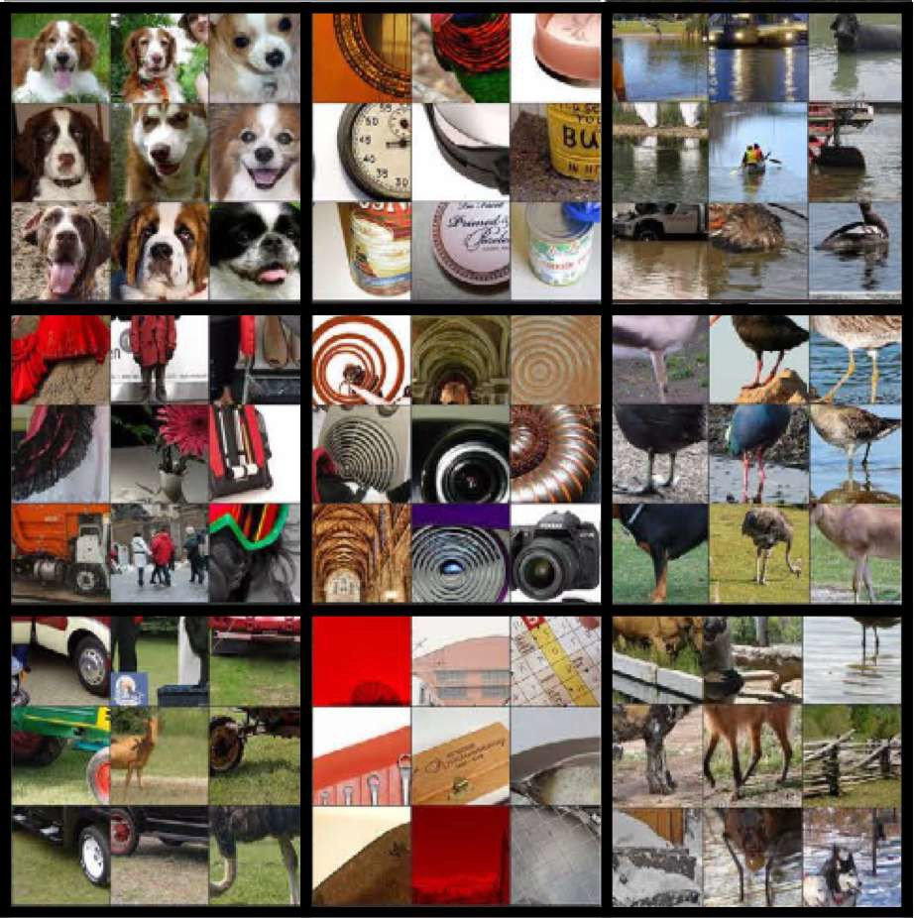
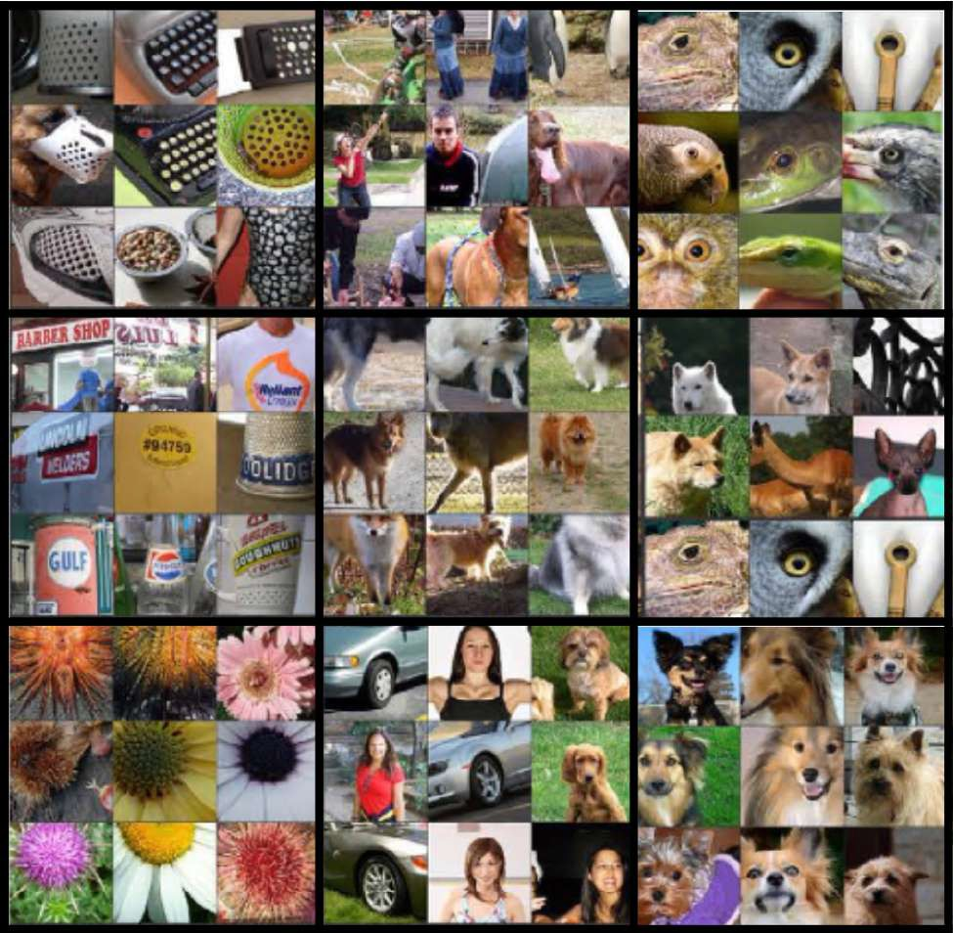
Visualizing deep layers
Layer 1
Layer 2
Layer 3
Layer 4
Layer 5

Slide 42
Visualizing deep layers: Layer 1
Layer 1
Layer 2
Layer 3
Layer 4
Layer 5

Slide 43
Visualizing deep layers: Layer 2
Layer 1
Layer 2
Layer 3
Layer 4
Layer 5

Slide 44
Visualizing deep layers: Layer 3
Layer 1
Layer 2
Layer 3
Layer 4
Layer 5

Slide 45
Visualizing deep layers: Layer 3
Layer 1
Layer 2
Layer 3
Layer 4
Layer 5

Slide 46
Visualizing deep layers: Layer 4
Layer 1
Layer 2
Layer 3
Layer 4
Layer 5

Slide 47
Visualizing deep layers: Layer 5
Layer 1
Layer 2
Layer 3
Layer 4
Layer 5

Slide 48
Neural Style
Transfer
Cost function

Slide 49
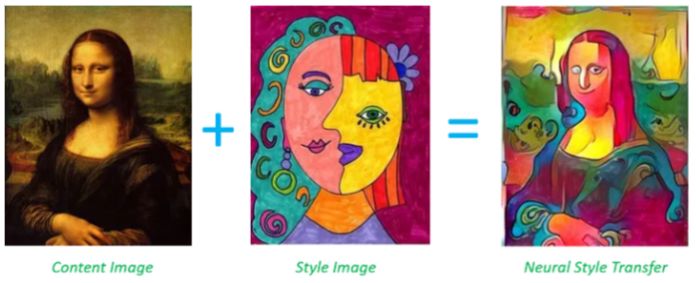
Cost function
Neural style transfer is one of the application of Conv nets.
Neural Style Transfer is the process of using a convolutional neural network to transfer the style of one image (style image S) to another image (content image C) and generate a new image G.

Slide 50
Cost function
To implement this technique, we need to define a cost function that measures how good a generated image is. This cost function will be minimized using gradient descent to generate the desired image.
The cost function consists of two parts: the content cost and the style cost.
- The content cost measures how similar the content of the generated image is to the content of the content image.
- The style cost measures how similar the style of the generated image is to the style of the style image.
We weight these costs using hyperparameters alpha and beta to control the relative importance of each.

Slide 51
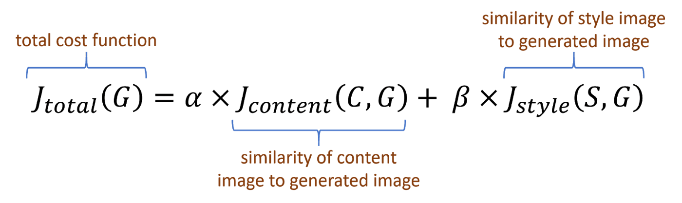
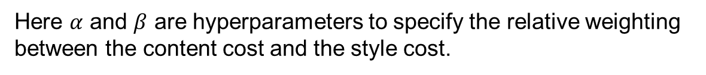
Cost function
Content C
Style S
Here $α$ and $β$ are hyperparameters to specify the relative weighting between the content cost and the style cost.
Generated image G

Slide 52
Find the generated image G
The Neural Style Transfer Algorithm was originally proposed by Leon Gatys, Alexander Ecker, and Matthias Bethge. Their paper is not too difficult to read, so it is recommended to check it out for more details on the algorithm.
To implement the algorithm, we start by randomly initializing the generated image. Then we minimize the cost function using gradient descent to update the pixel values of the generated image until we obtain an image that combines the content of the content image with the style of the style image.

Slide 53

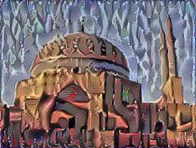
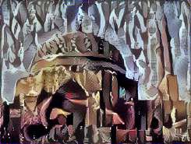
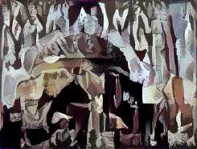

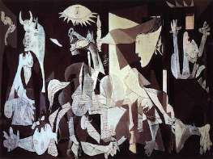
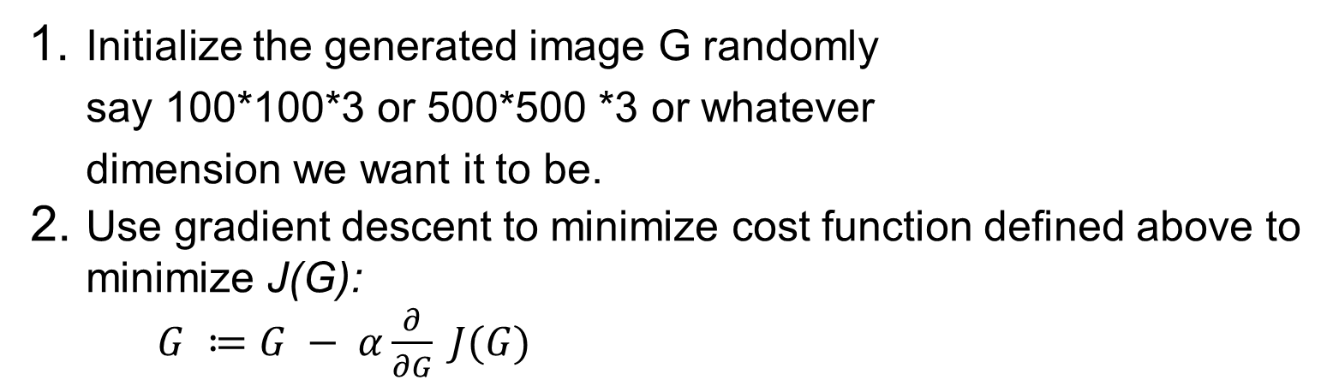
Find the generated image G
Initialize the generated image G randomly say 100*100*3 or 500*500 *3 or whatever dimension we want it to be.
Use gradient descent to minimize cost function defined above to minimize J(G):
$G ≔G − α\frac{∂}{∂G} J(G)$

Slide 54
Neural Style
Transfer
Content cost
function

Slide 55
Content cost function
The content cost function in the neural style transfer algorithm measures the similarity between the content of the content image and the generated image. It is defined by using a pre-trained ConvNet, such as a VGG network, and choosing a hidden layer "l" somewhere in the middle of the layers of the neural network.

Slide 56
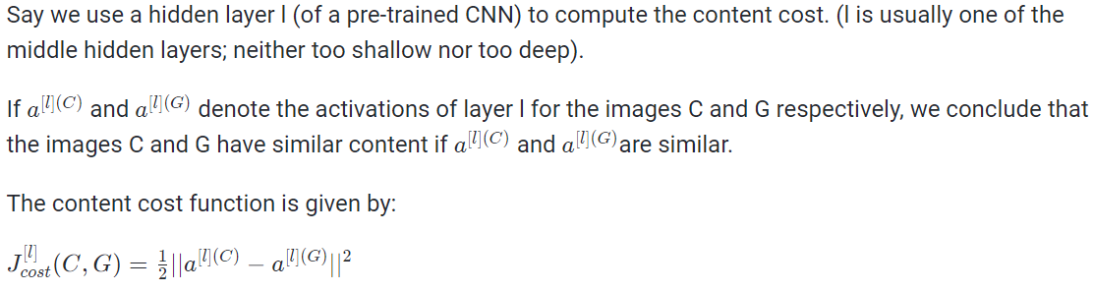
Content cost function

Slide 57
Neural Style
Transfer
Style cost function

Slide 58
Meaning of the “style” of an image
In the previous section, the focus was on defining the style cost function for the neural style transfer algorithm.
The style of an image is defined as the correlation between activations across different channels in a chosen layer, which is typically computed using a pre-trained convolutional neural network such as VGG.
The style matrix, denoted as G, is computed by taking the sum of products of activations for all pairs of channels in a given layer, and then normalizing it by the number of positions (height, width) and number of channels in that layer.
The style cost function is defined as the Frobenius norm of the element-wise difference between the style matrix of the style image and the generated image, squared and normalized by some hyperparameters.

Slide 59
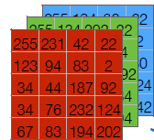

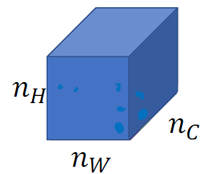
Meaning of the “style” of an image
⋮
"#
Say you are using layer l’s activation to measure “style.”
Define style as correlation between activations across channels.
How correlated are the activations across different channels?
%'
%₍
%&

Slide 60
Intuition about style of an image
Neural style transfer involves computing a style cost function using multiple layers in a neural network to measure low-level and high-level features of an image.
The style cost function is combined with a content cost function using hyperparameters alpha and beta to define an overall cost function, and the goal is to minimize this cost function using optimization algorithms like gradient descent to generate a visually pleasing output.
Notes:
To get visually pleasing results, the style cost function is typically computed using multiple layers in the neural network, which measure both low-level and high-level features of the image.
The overall cost function of the neural style transfer algorithm is defined as a weighted sum of the content cost and the style cost, with hyperparameters alpha and beta controlling the relative importance of each term. The objective is to find an image that minimizes this cost function using gradient descent or another optimization algorithm.

Slide 61
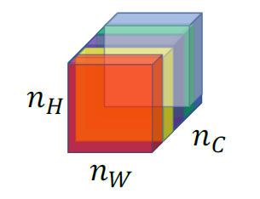
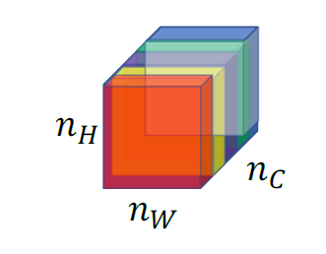
Intuition about style of an image
Style image Generated Image
%'
%'
%₍
%₍
%&
%&

Slide 62
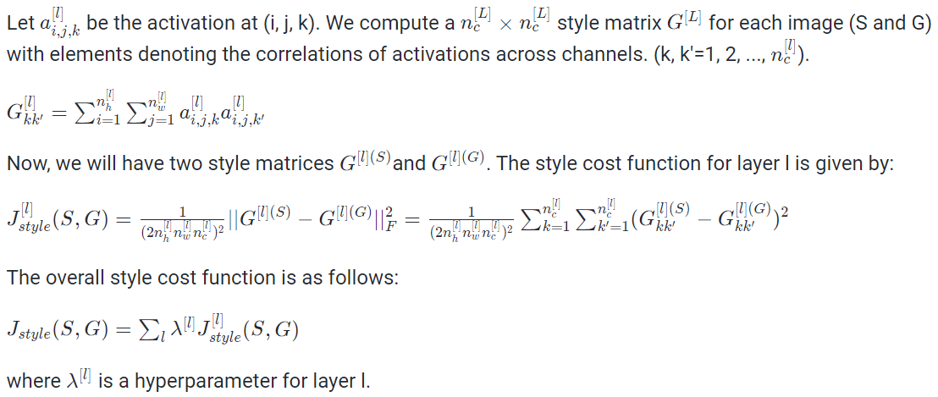
Style cost function

Slide 63
Style cost function
How to perform convolutions over 1D or 3D data, which are commonly found in applications such as natural language processing and video processing.
- Convolutions over 1D data are typically used for tasks such as text classification, where the input is a sequence of words.
- Convolutions over 3D data are used for tasks such as video classification, where the input is a sequence of frames. The process of convolution is similar to that of 2D convolutions, but with some differences in the dimensions of the input, kernel, and output.

Slide 64
Convolutional
Networks in 1D
or 3D
1D and 3D generalizations of models

Slide 65
1D and 3D generalizations of models
How ConvNets can be generalized from 2D data to 1D and 3D data?
- Consider the example of an EKG signal as an example of 1D data and explain how a 1D filter can be used to detect features in different positions along the time series. They also mention that recurrent neural networks are typically used for sequence data, but ConvNets can be applied to some problems as well.

Slide 66
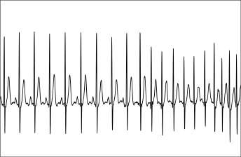
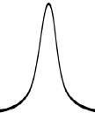
Convolutions in 2D and 1D
∗
2D filter
5×5
2D input image
14×14
14 x 14 x 3 * 5 x 5 x 3 >>> 10 x 10 x 16
10 x 10 x 16 * 5 x 5 x 16 >>> 6 x 6 x 32
14 x 1 * 5 x 1 >>> 10 x 16
10 x 16 * 5 * 16 >>> 6 * 32
∗
1 | 20 | 15 | 3 | 18 | 12 | 4 | 17
1 | 3 | 10 | 3 | 1

Slide 67
3D data
For 3D data, consider the example of a CT scan, which is a type of medical scan that gives a 3D model of the body.
3D volume can be convolved with a 3D filter, and use an example of a 14 x 14 x 14 volume convolved with a 5 x 5 x 5 filter, which gives a 10 x 10 x 10 output. Number of channels in the input and output volumes must match, and use an example of using 16 filters to get a 10 x 10 x 10 x 16 output.

Slide 68
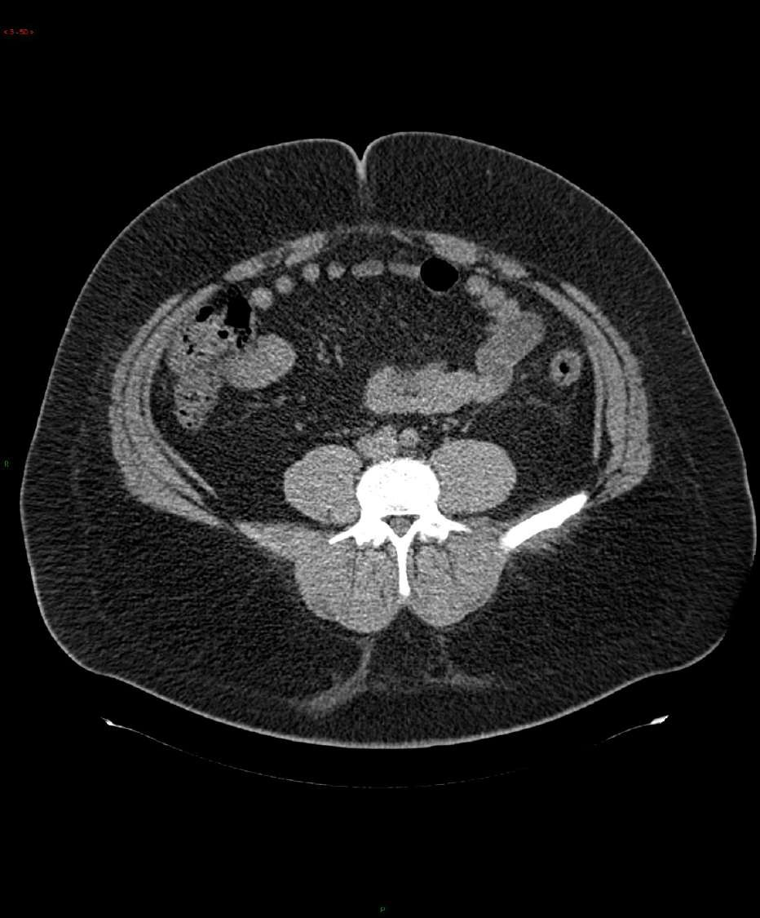
3D data

Slide 69
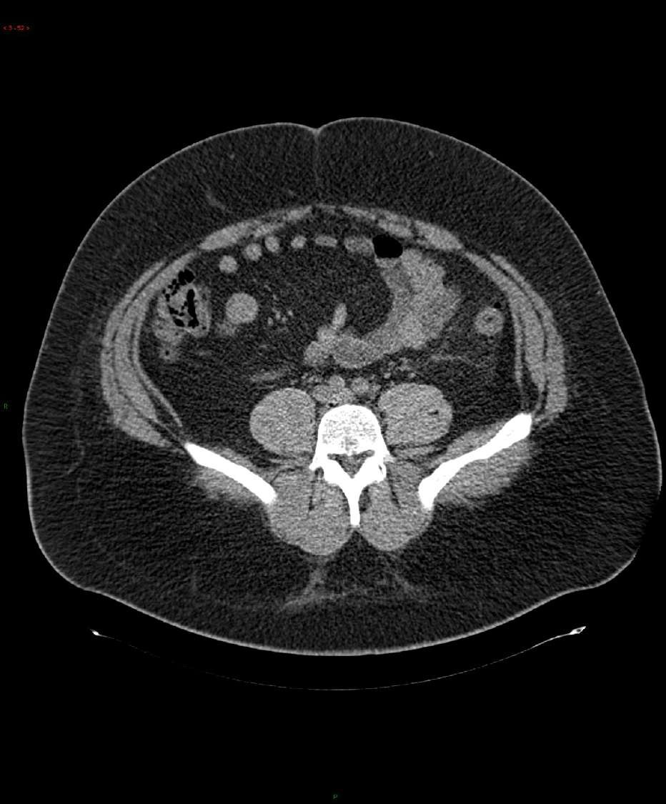
3D data

Slide 70
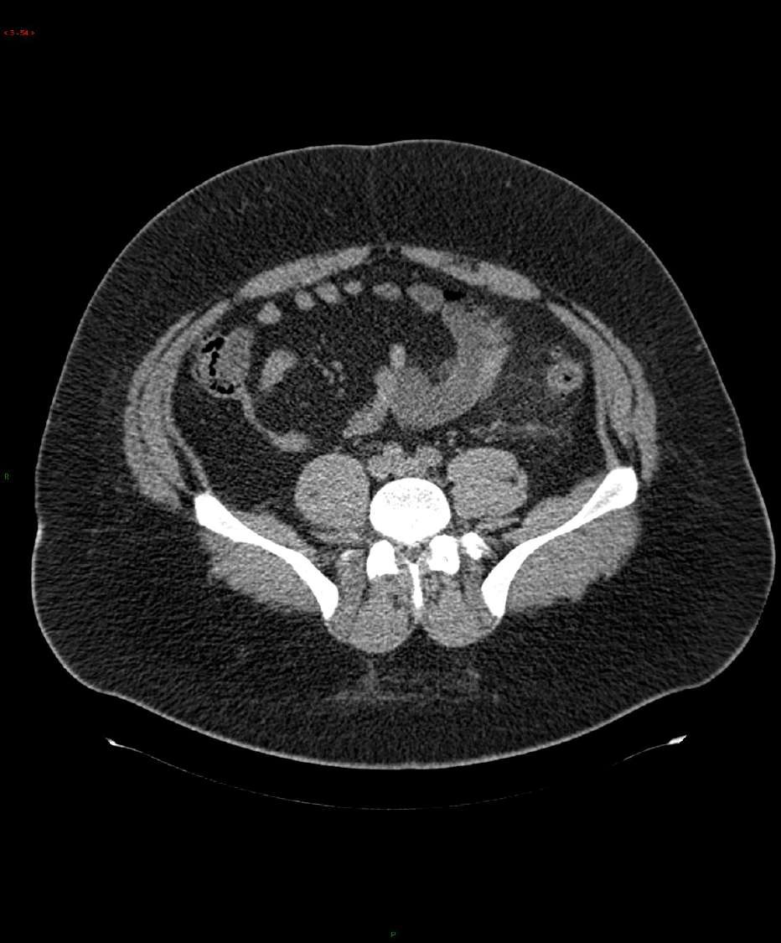
3D data

Slide 71
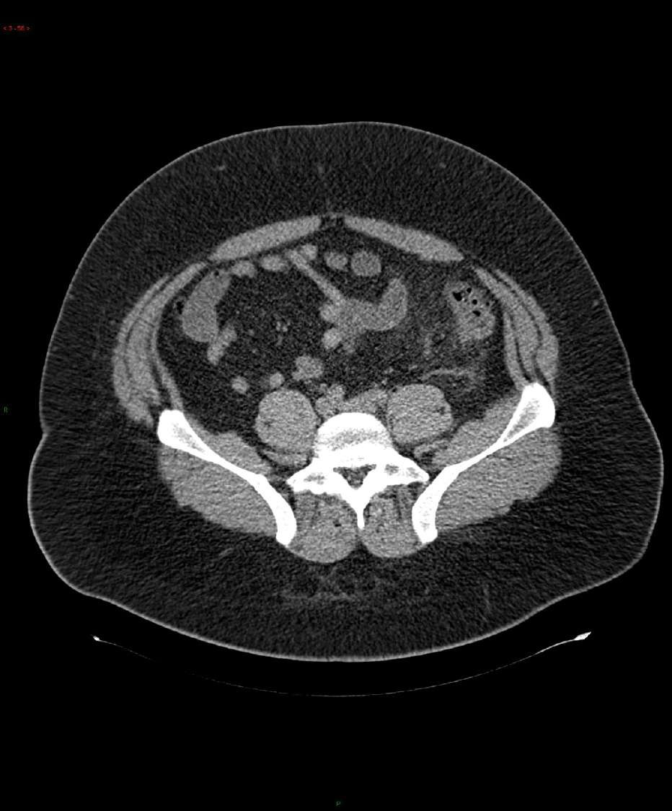
3D data

Slide 72
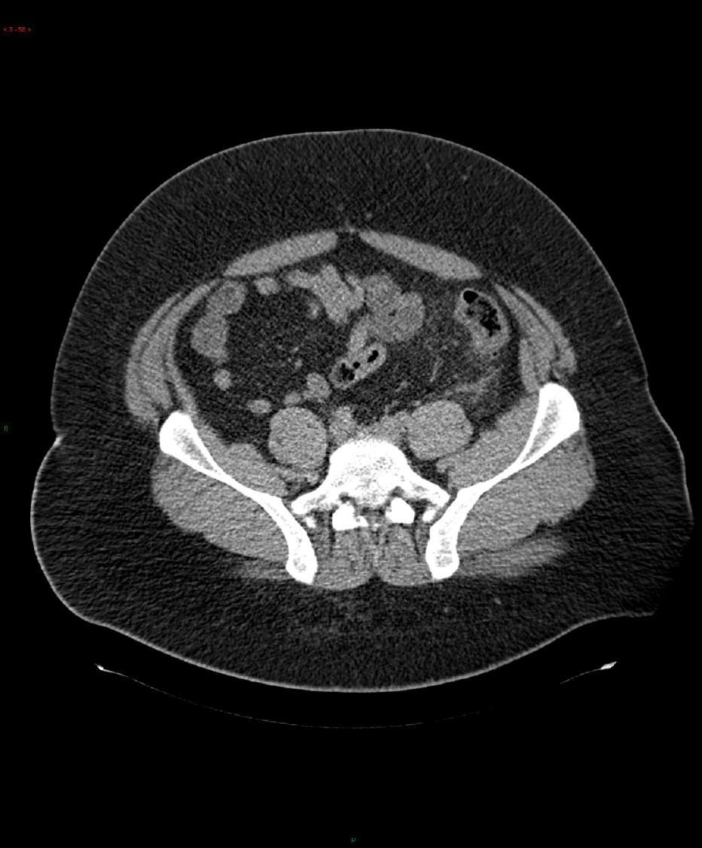
3D data

Slide 73
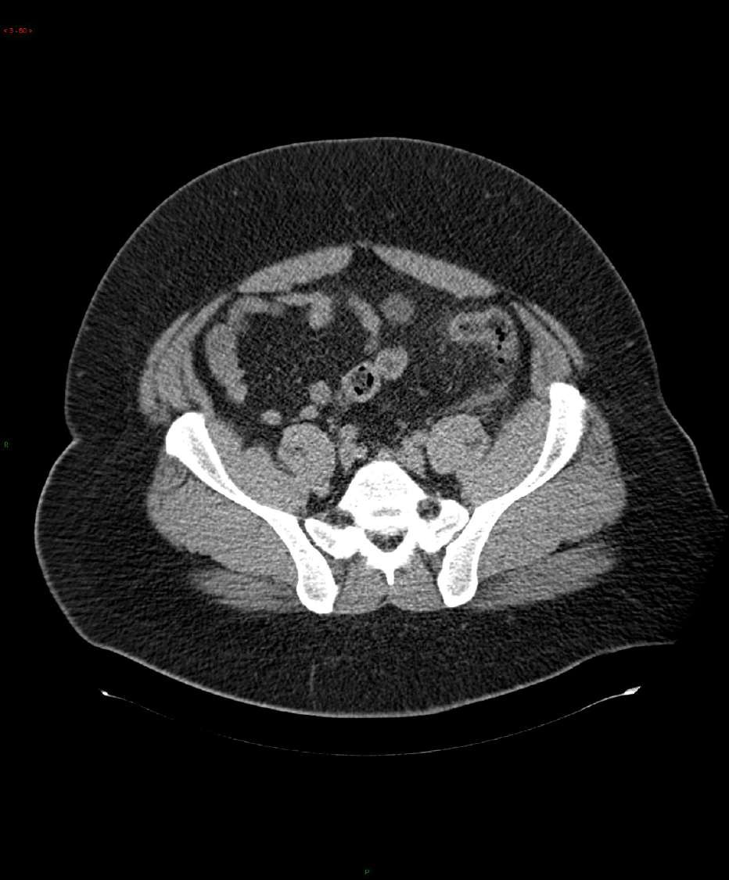
3D data

Slide 74
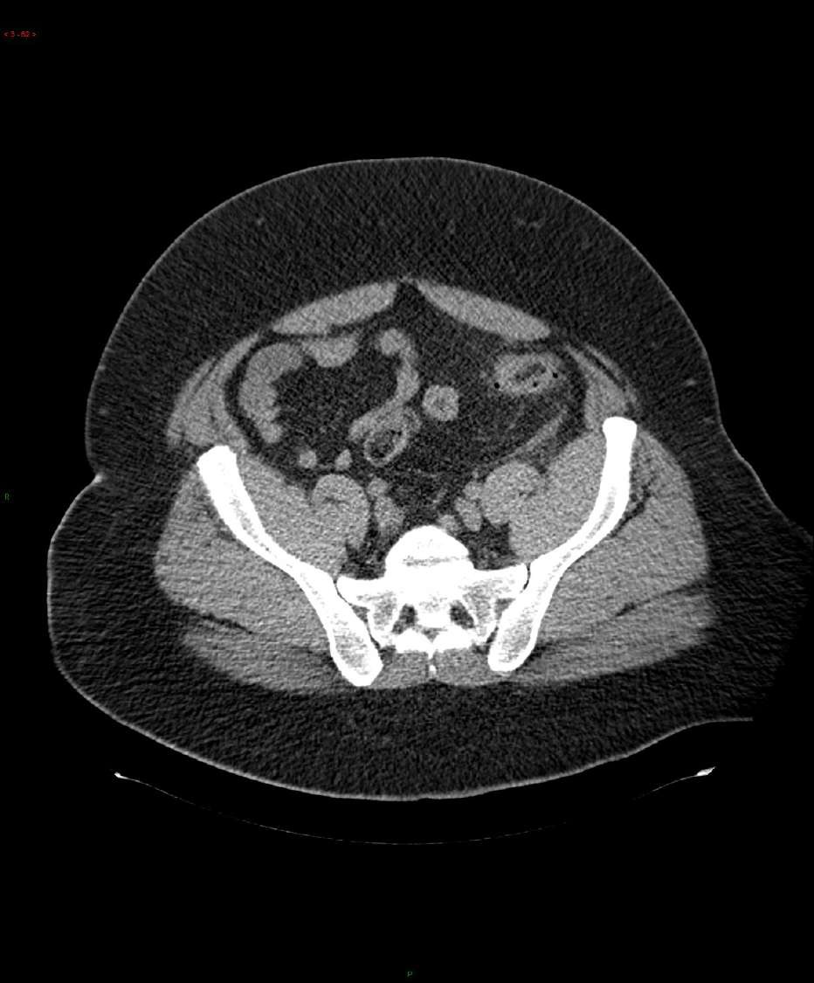
3D data

Slide 75
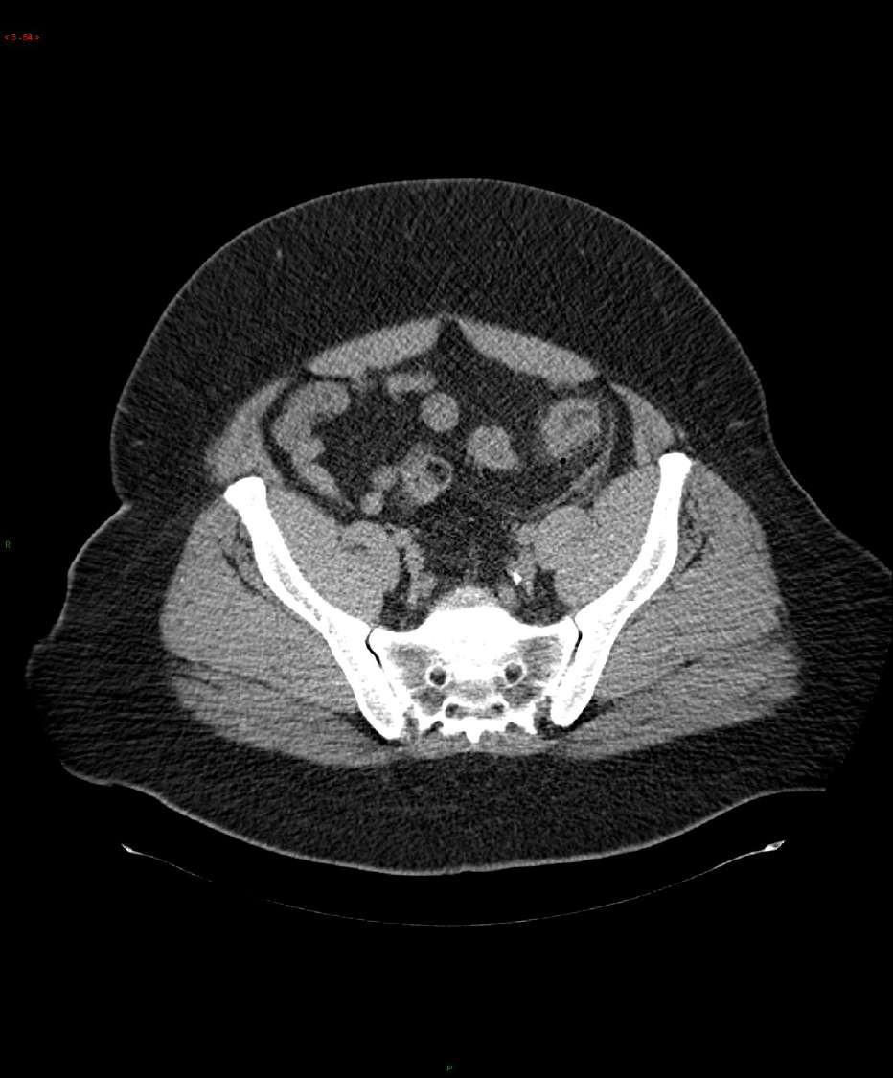
3D data

Slide 76
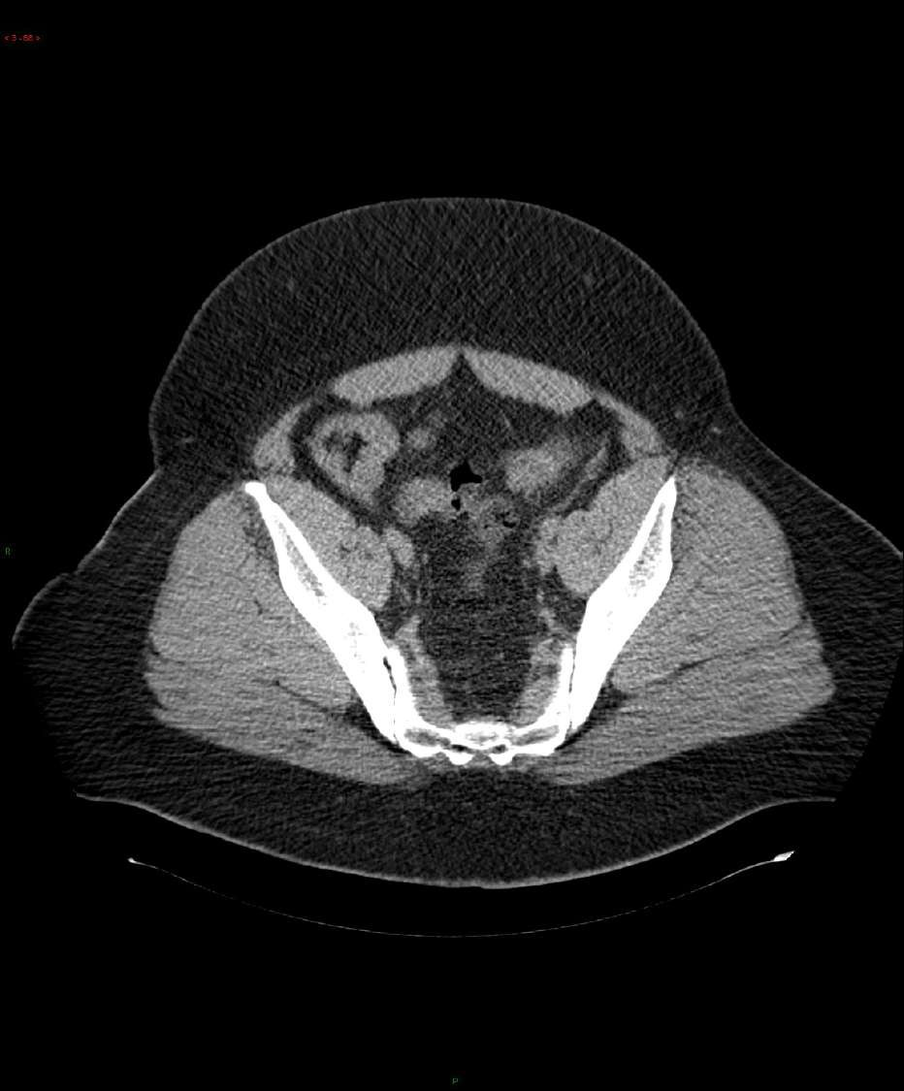
3D data

Slide 77
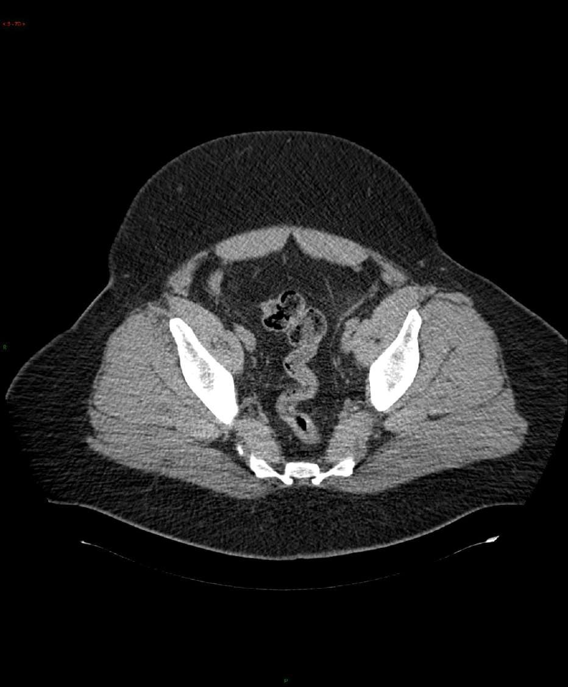
3D data

Slide 78
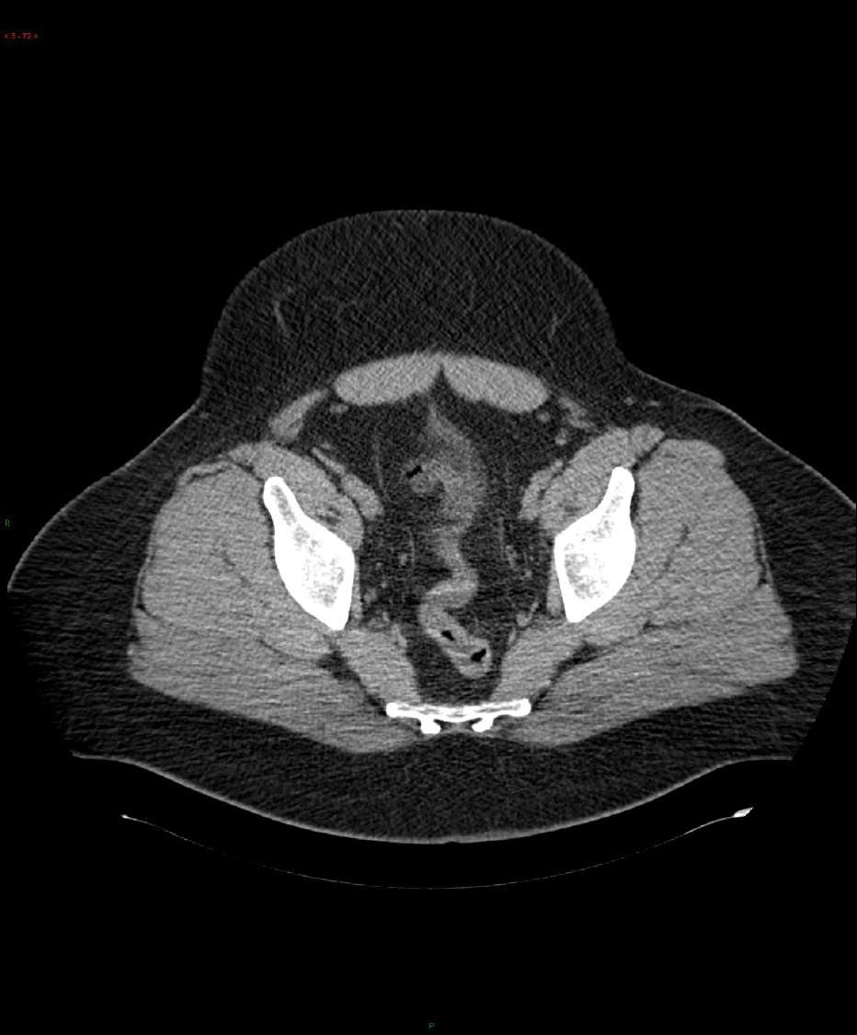
3D data

Slide 79
3D convolution
Movie data can be treated as a 3D volume, where the different slices are different slices in time through the movie, and ConvNets can be used to detect motion or people taking actions in movies.

Slide 80
3D convolution
∗
3D filter
3D volume
14 x 14 x 14 x 1 * 5 x 5 x 5 x 1
>>>>> 10 x 10 x 10 x 16 ( 16 filter )
5 x 5 x 5 x 16
>>>>> 6 x 6 x 6 x 32 ( 32 filter )

Slide 81
Summarization
Face recognition identifies individuals based on facial features.
One-shot learning classifies objects with minimal examples.
Siamese networks learn similarity metrics, often used in face verification and one-shot learning.
Triplet loss minimizes distances between similar pairs and maximizes distances between dissimilar pairs in Siamese networks.
Neural style transfer merges content and style for artistic images.
Deep ConvNets learn hierarchical features, capturing basic to abstract features.
Cost functions measure dissimilarity during neural network training. Content cost preserves content features in style transfer. Style cost transfers artistic styles to generated images.
Neural network architectures can generalize to 1D sequences or 3D data, enabling diverse applications.
Notes:
Face Recognition:
Face recognition is a technology used to identify or verify a person's identity by analyzing and comparing patterns based on facial features from an image or video frame.
One-Shot Learning:
One-shot learning refers to the ability of a model to recognize or classify objects based on a single or a very few examples, which is particularly challenging for traditional machine learning algorithms.
Siamese Network:
A Siamese network is a type of neural network architecture designed to learn similarity metrics between input pairs. It is often used in tasks like face verification and one-shot learning.
Triplet Loss:
Triplet loss is a loss function used in Siamese networks. It minimizes the distance between anchor-positive pairs (similar items) and maximizes the distance between anchor-negative pairs (dissimilar items) in the embedding space.
Neural Style Transfer:
Neural style transfer is an algorithmic technique that merges the content of one image with the style of another, creating visually appealing and artistic images. It involves optimizing an image to match both content and style features.
What Deep ConvNets Learn:
Deep ConvNets (Convolutional Neural Networks) learn hierarchical features from data. In early layers, they capture basic features like edges and textures, while deeper layers learn complex, abstract features specific to the given dataset.
Cost Function:
A cost function (or loss function) measures the dissimilarity between the predicted output and the actual target values during the training of a neural network. It guides the optimization process.
Content Cost Function:
In neural style transfer, the content cost function measures the difference between the content of the generated image and the content of the reference image, guiding the preservation of content features.
Style Cost Function:
The style cost function measures the difference in style features between the generated image and the style reference image. It guides the transfer of artistic styles to the generated image.
1D and 3D Generalizations of Models:
Neural network architectures can be extended to handle 1D sequences (such as text) or 3D data (like video frames or medical images), allowing the application of deep learning to diverse data types.

